Slide 1
Cardiorespiratory physiology and energetics of reef fishes
Timothy Clark

Slide 2
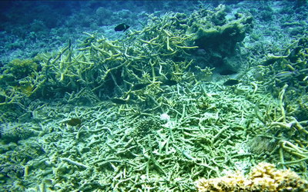
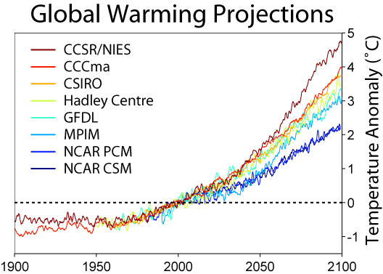
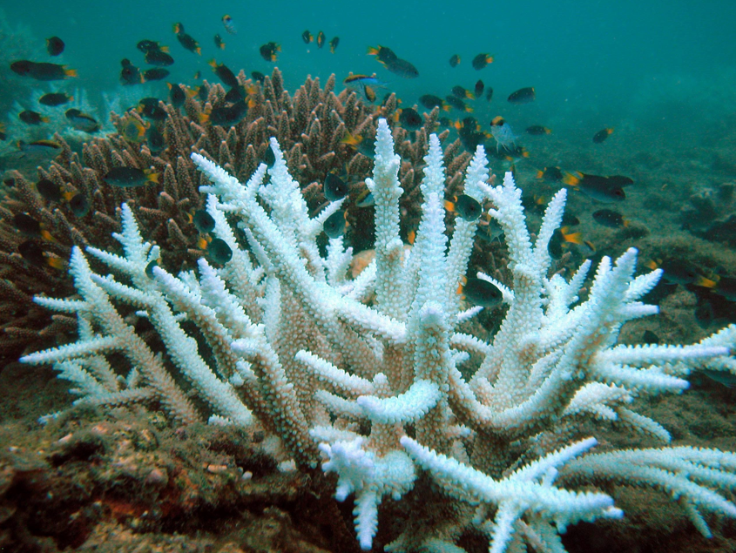
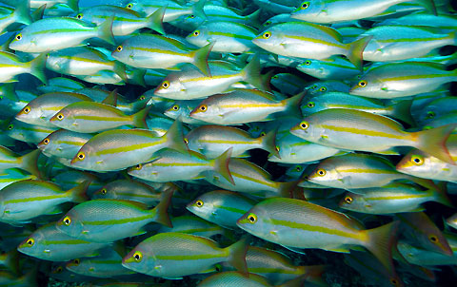
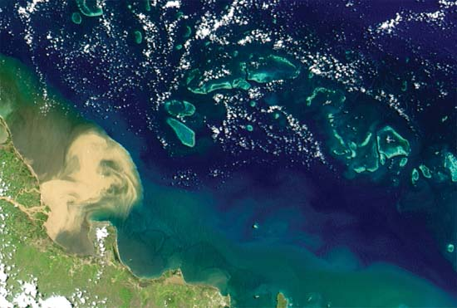
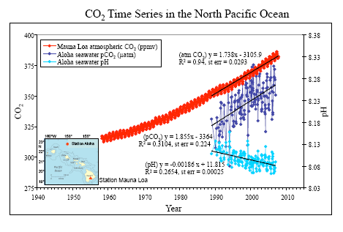
Great Barrier Reef and environmental change

Slide 3
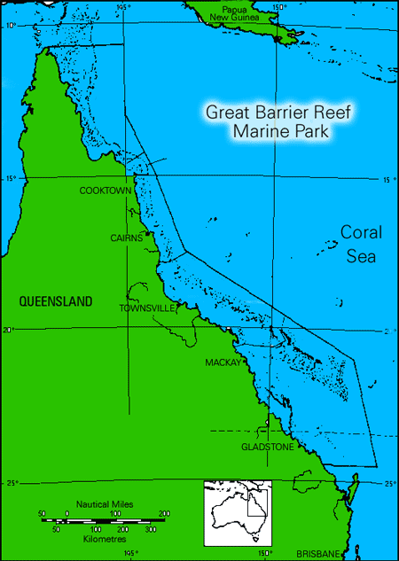
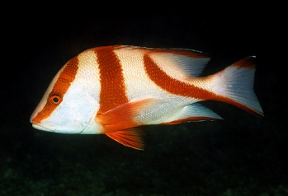
Environmental change and GBR fishes
Home ranges
Distributions
Persistence
Food webs
etc
Attainment and efficient utilisation of energy is fundamental
Energy processing relies on oxygen transport from environment to tissues
Notes:
These environmental changes likely to influence whole range of attributes and processes... Perhaps greatest challenges are to quantify how env change is currently affecting these processes and forecast how fish pops will be affected in future. This is obviously a huge challenge but I think one of the most promising ways of moving forward is to take an ecophysiological approach on the basis that the attainment and...

Slide 4
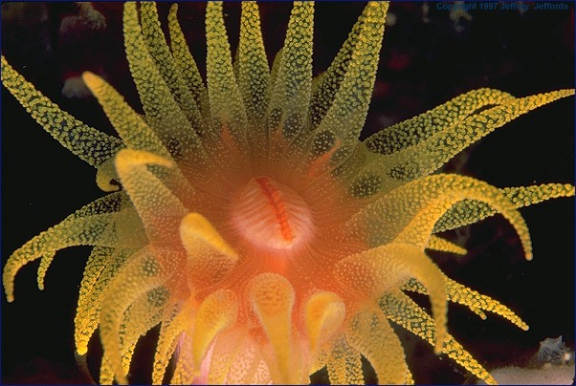
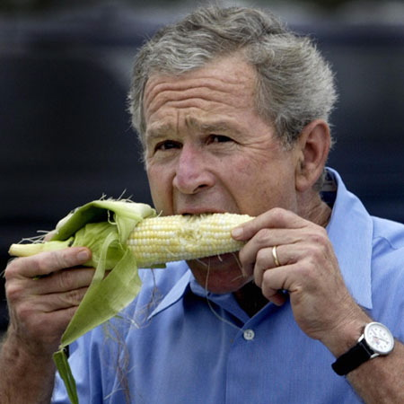
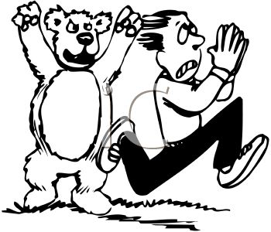

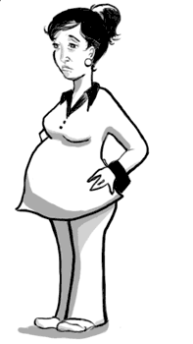

Oxygen – the fire of life!
O₂
Lungs / Gills
Blood
Circulation
Heart
O₂
...several trillion
Mitochondria
ATP (energy)
ATP (energy)

Slide 5
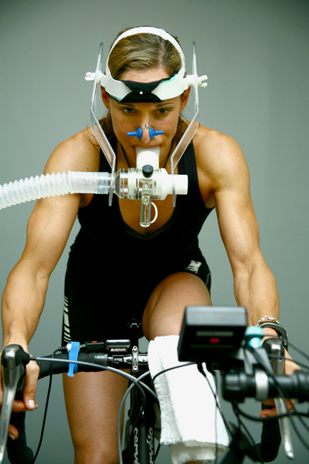
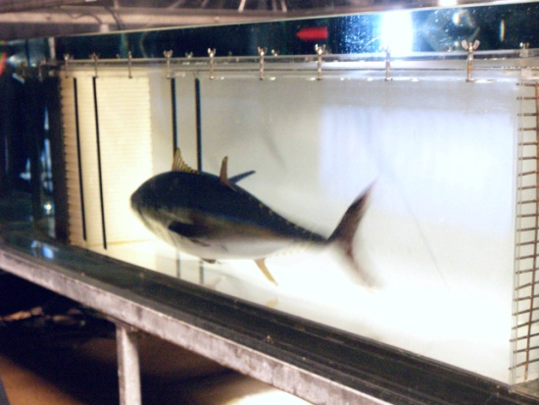
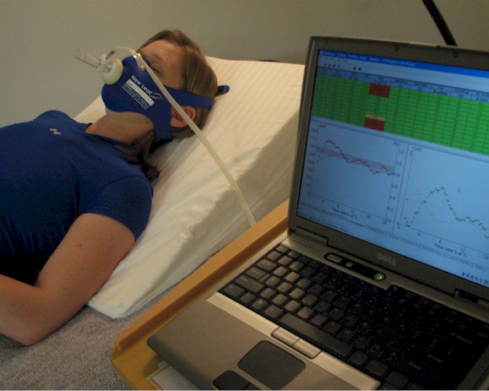
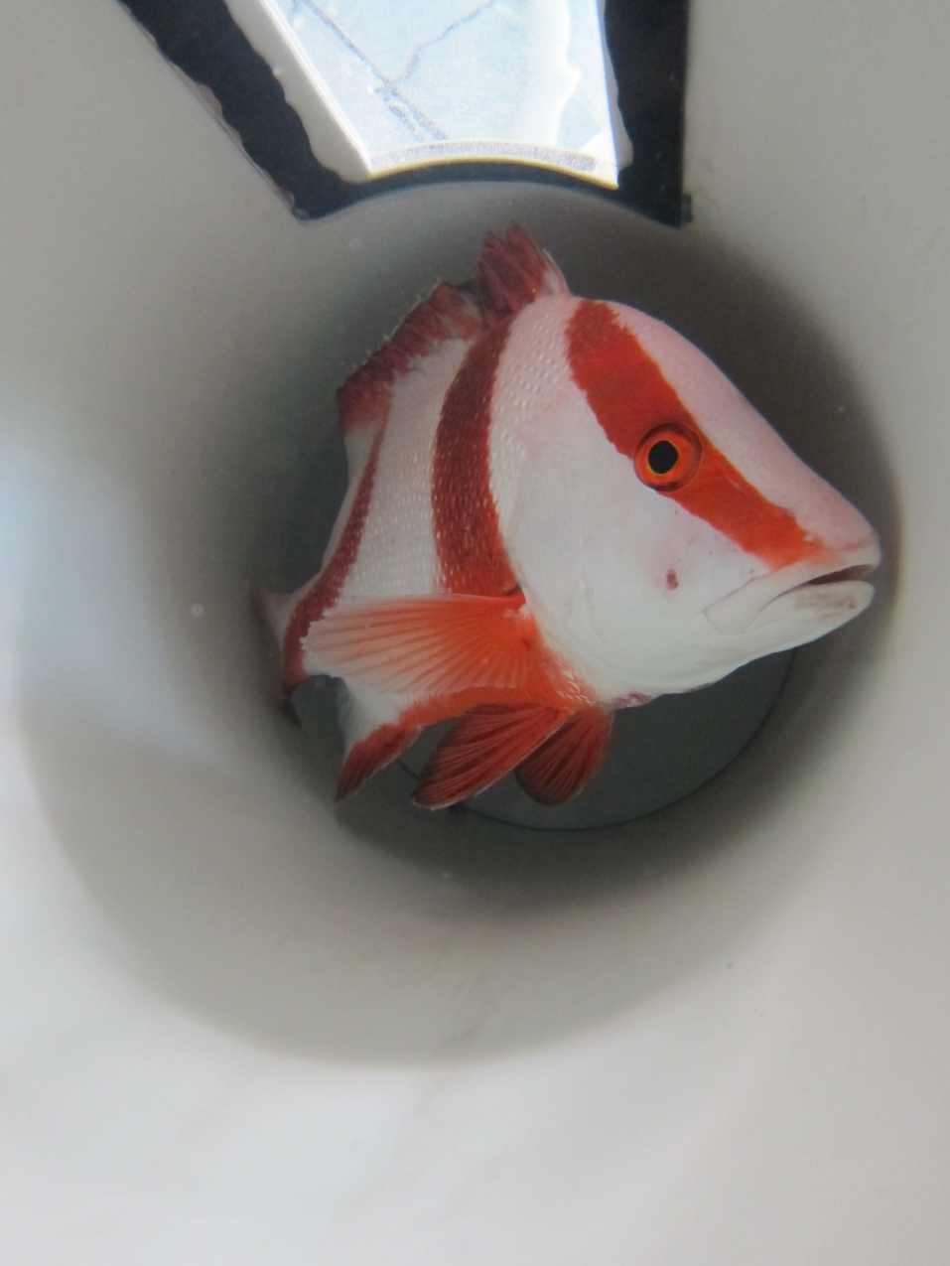
Aerobic scope
VO₂max
(or MO₂max)
Digestion
Reproduction
Growth
Locomotion
Aerobic scope
Aerobic metabolism
Rest
Maintenance
Notes:
This varies between species – whereas a tuna might be up here, a flounder would be expected to be down here. Also varies within species, for example within humans an athletic person may have a VO2max up here while a couch potato would have one down here, and therefore couldn’t achieve as many of these processes simultaneously.

Slide 6
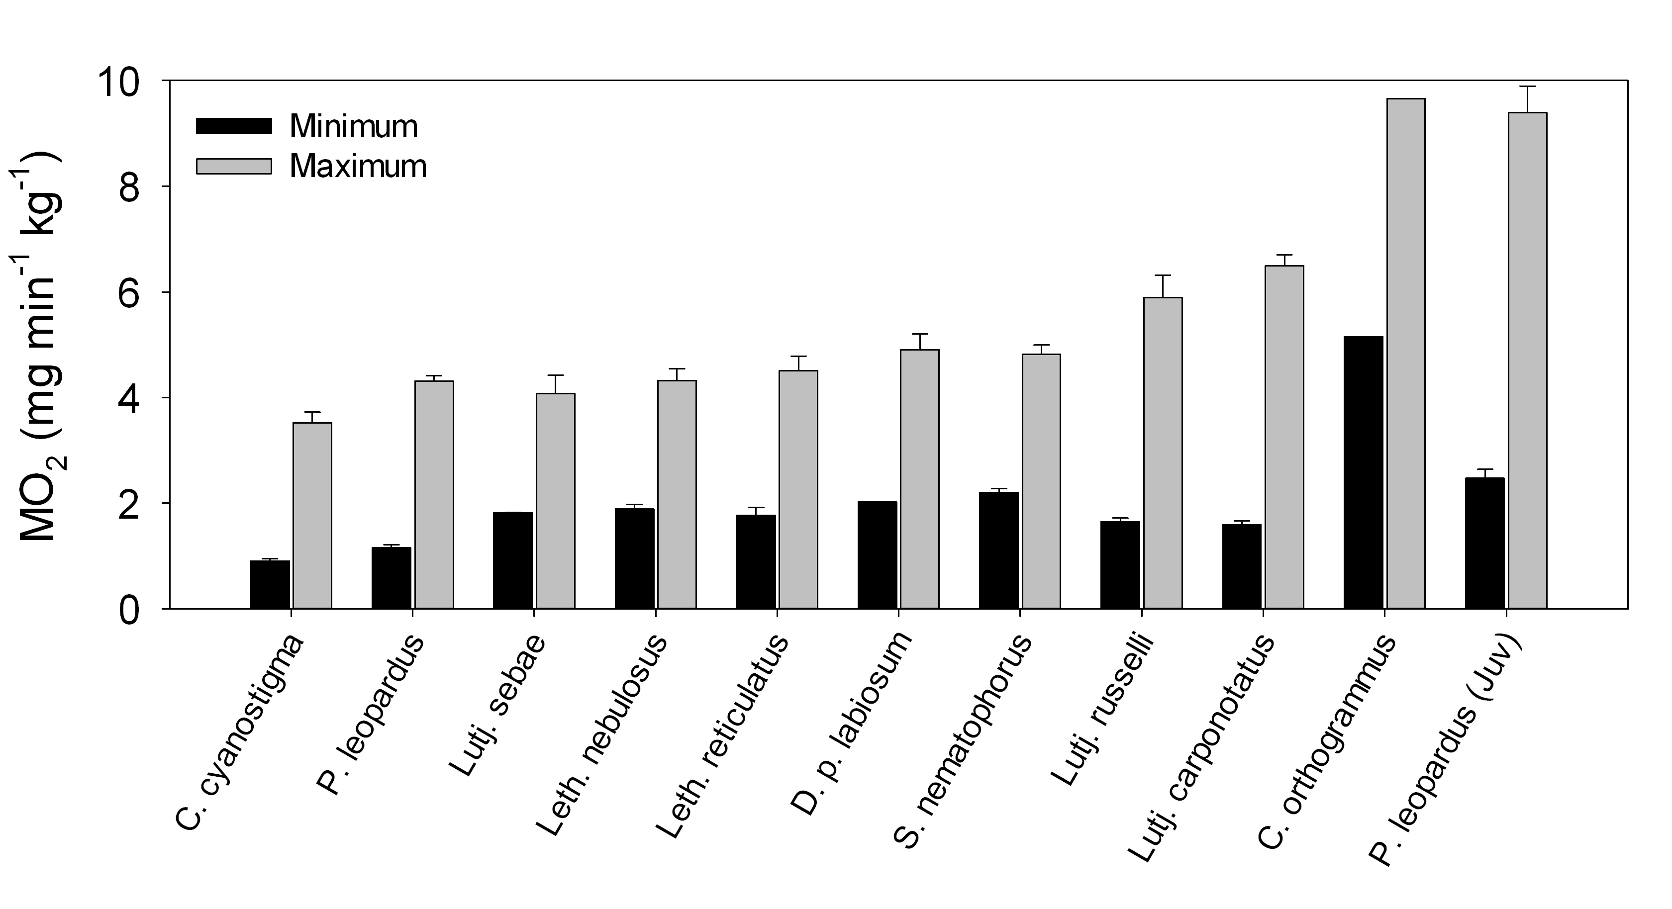
Movement ecology & metabolic capacity
28ºC
Increasing home range
P. leopardus
Notes:
Earlier this year went to lizard island and measured the min and max metabolic rates of several species to determine if any correlation with ecology. Although don’t know a whole lot about movement and ecology of juvenile trout, metabolic measurements provide some insight suggesting active high energy demand lifestyle

Slide 7
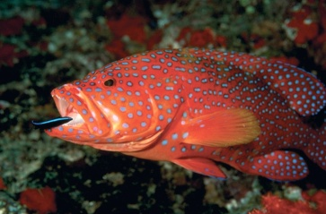
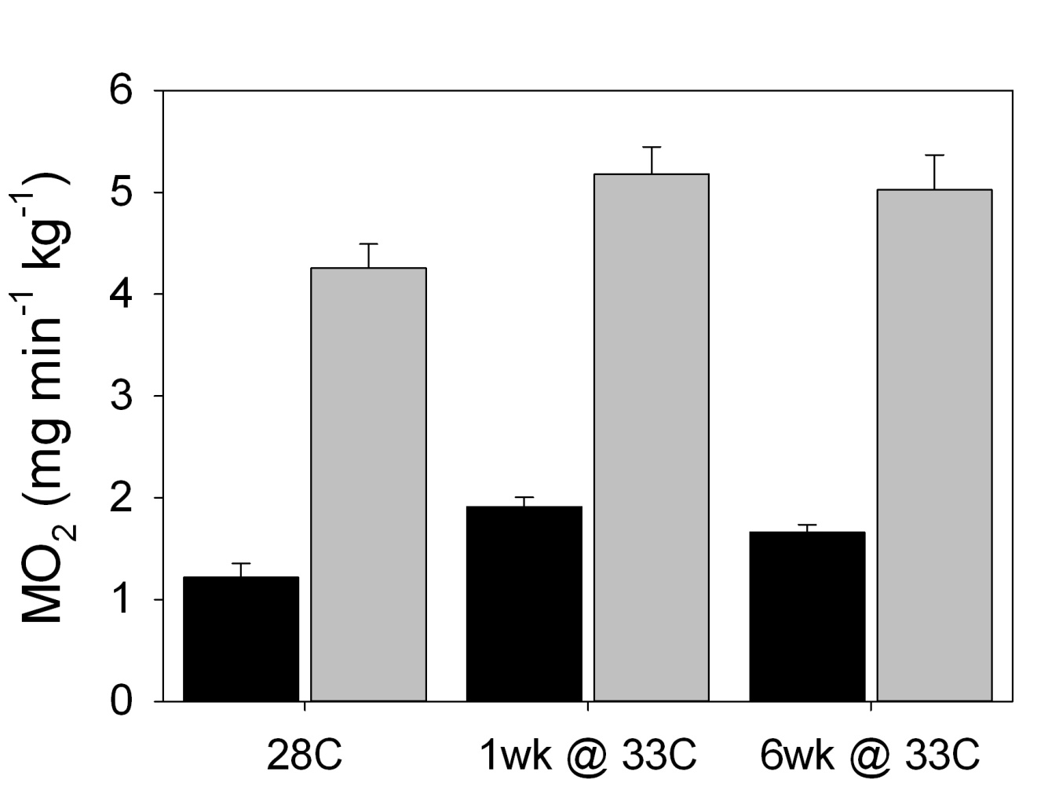
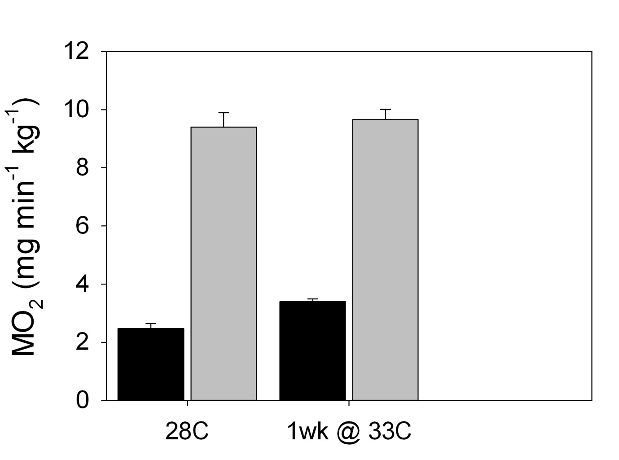
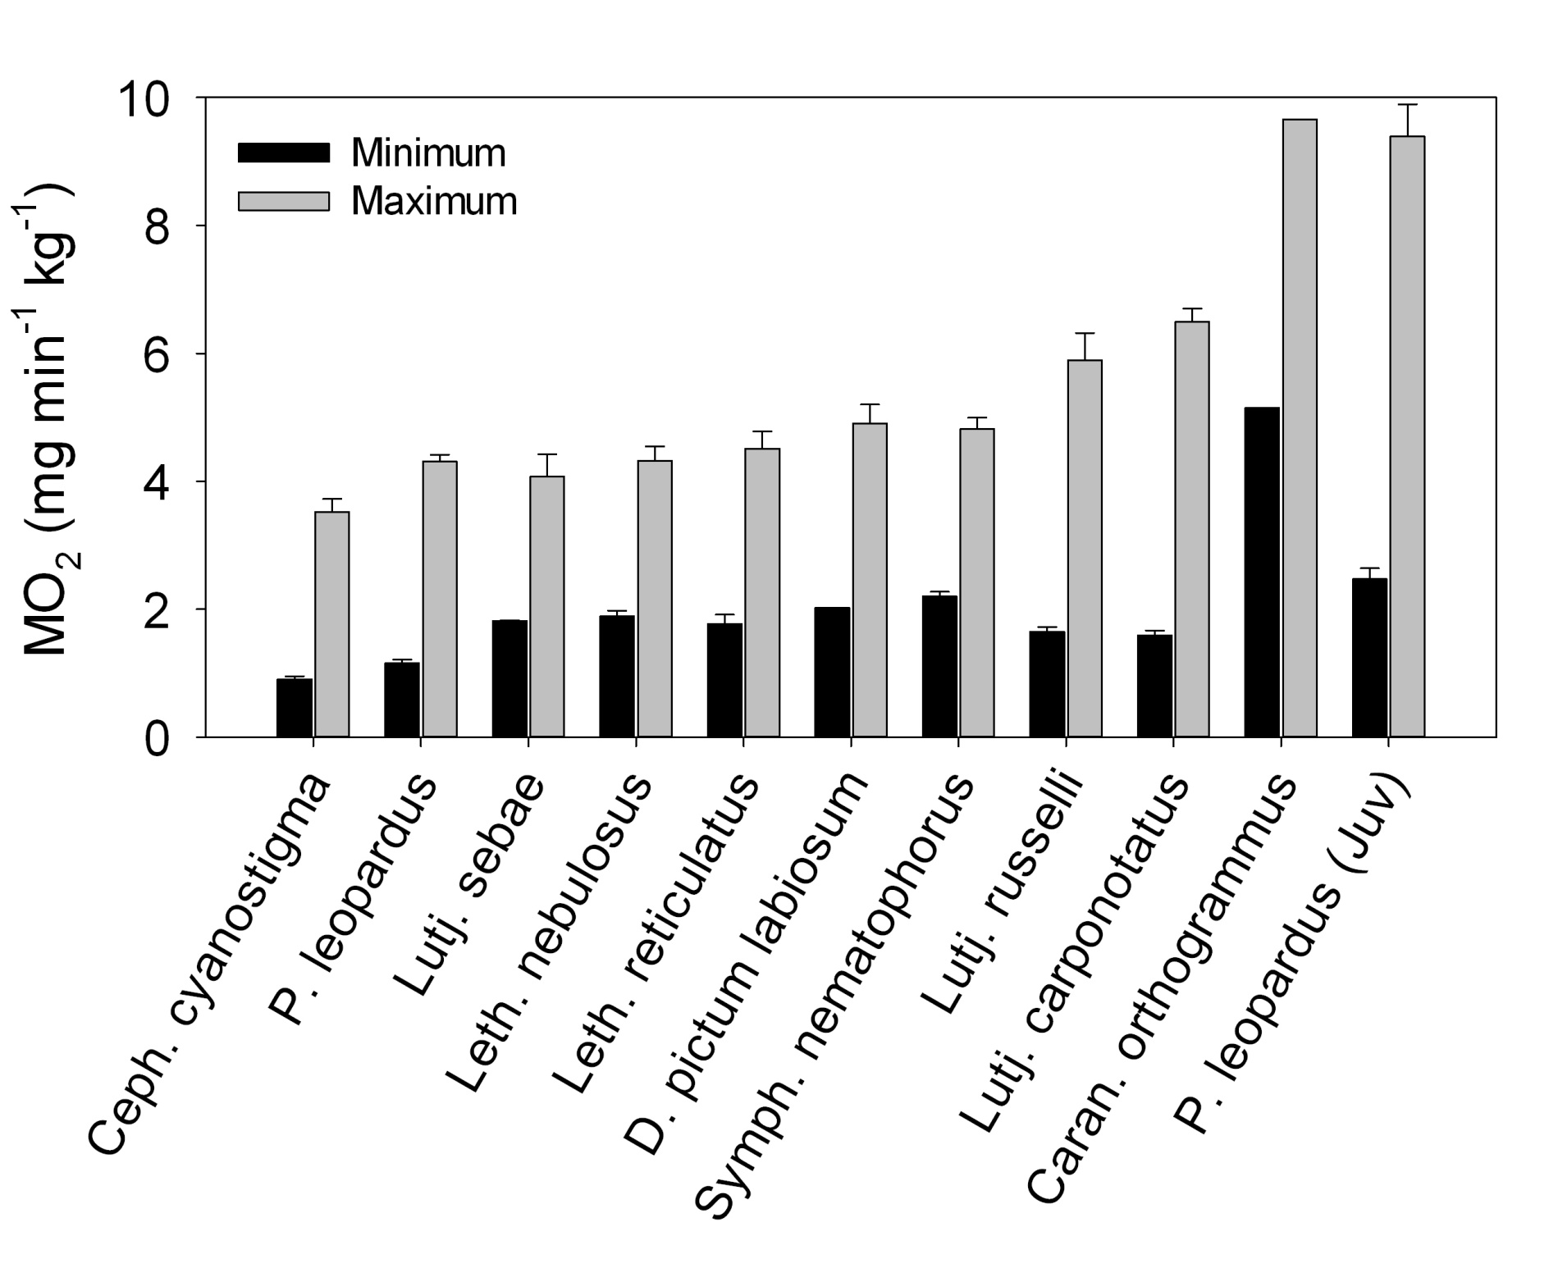
Environmental change
*
3.3
3.4
6.3
3.0
6.9
*
*
*
Adults
Juveniles
Notes:
But the metabolic capacities are not set in stone – they can be modulated by environmental variables...for example, here are some data from a study we did on coral trout examining thermal acclimation of metabolism

Slide 8
Estimating metabolic rate of free-living fishes?
Respiratory SA / vol. / rate
Haemoglobin
binding
Haemoglobin conc.
Heart rate
Heart vol. / rate
O₂
Mitochondria vol.
ATP (energy)

Slide 9
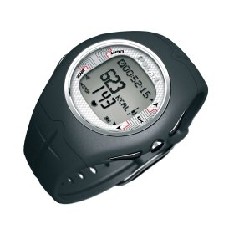
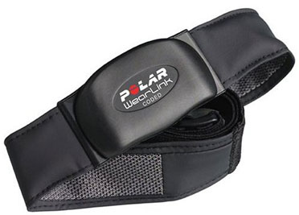

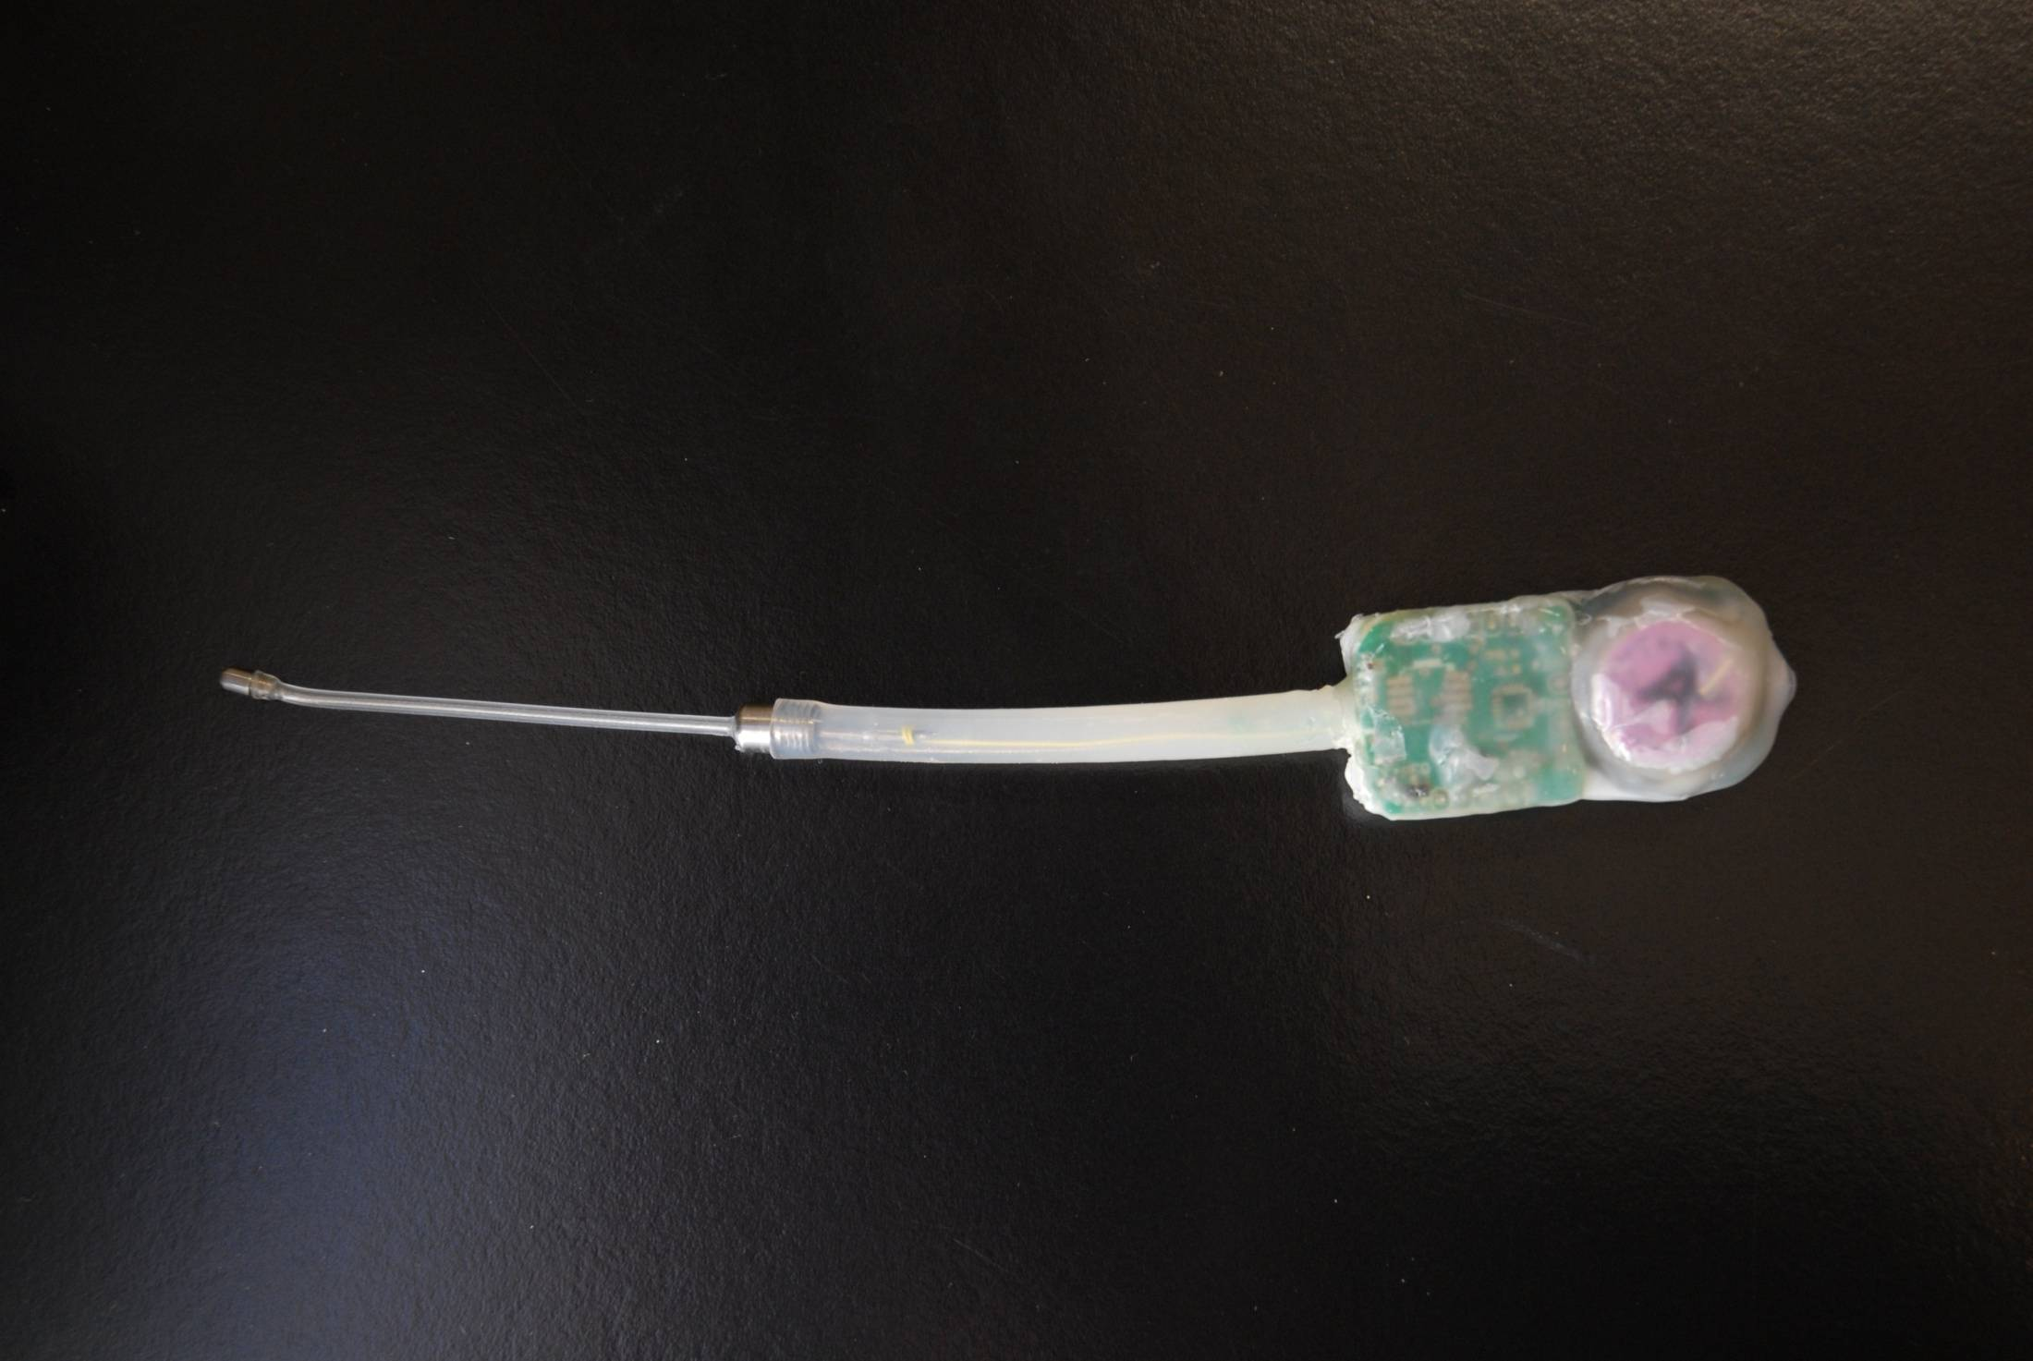
Beyond the lab
Depth
Temperature
Acceleration
ECG
Fish >1 kg

Slide 10
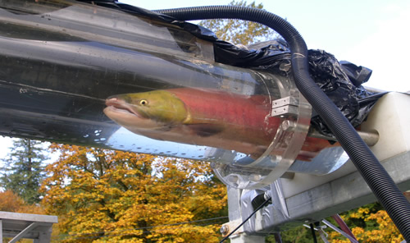
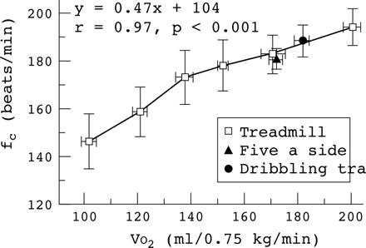
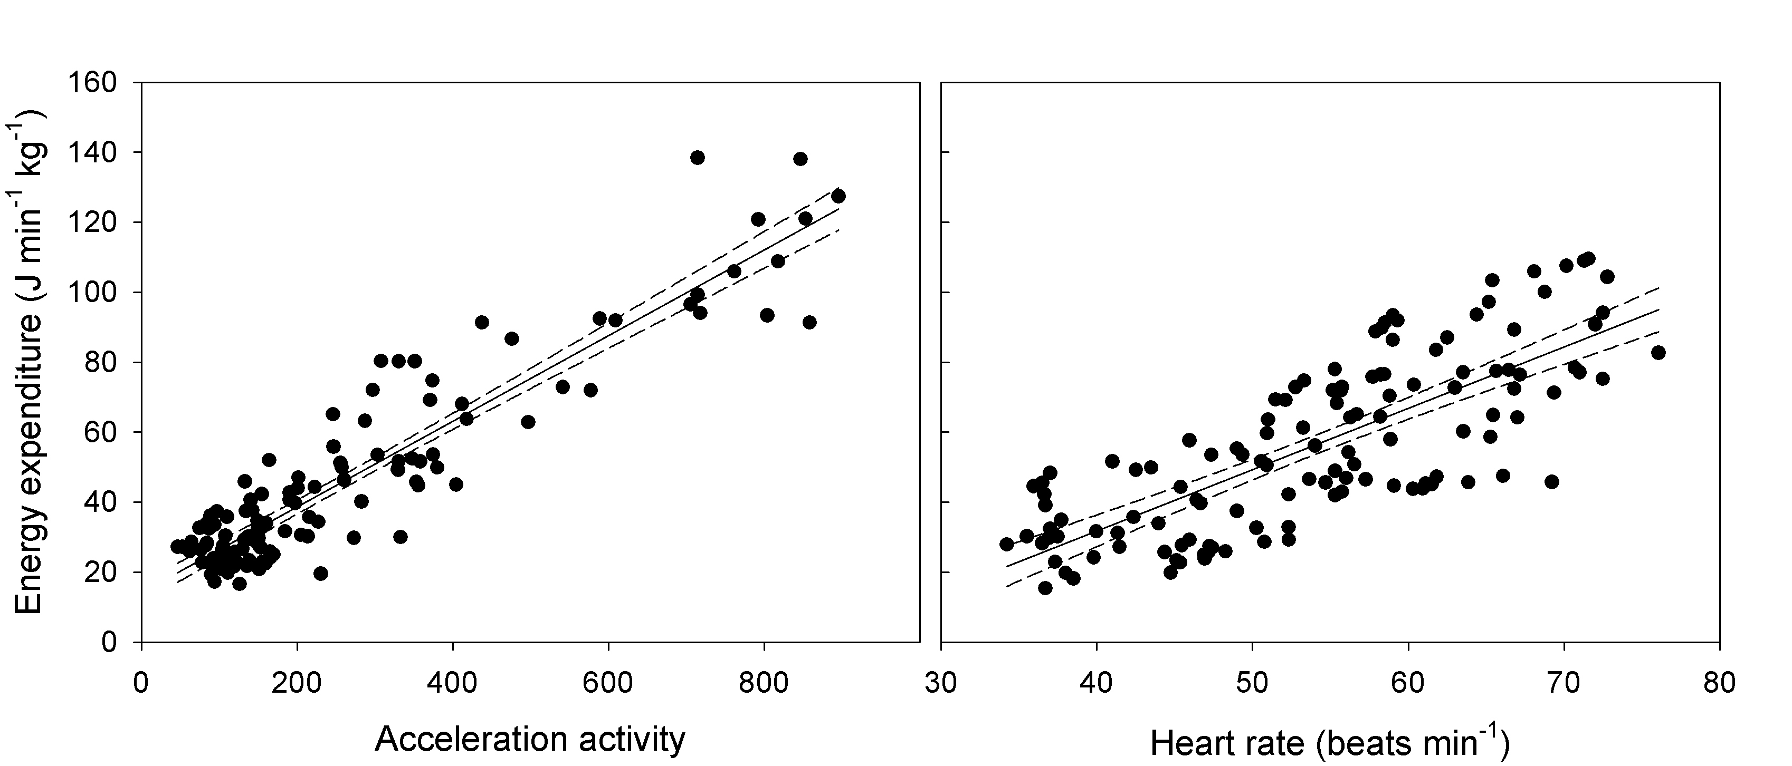
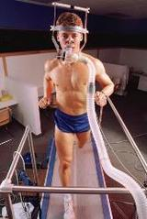
Calibration experiments
Metabolic rate
Heart rate
Metabolic rate (J/min/kg)
Acceleration
Heart rate

Slide 11
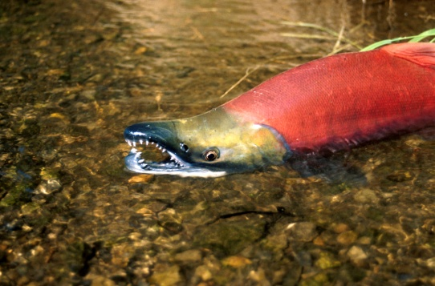
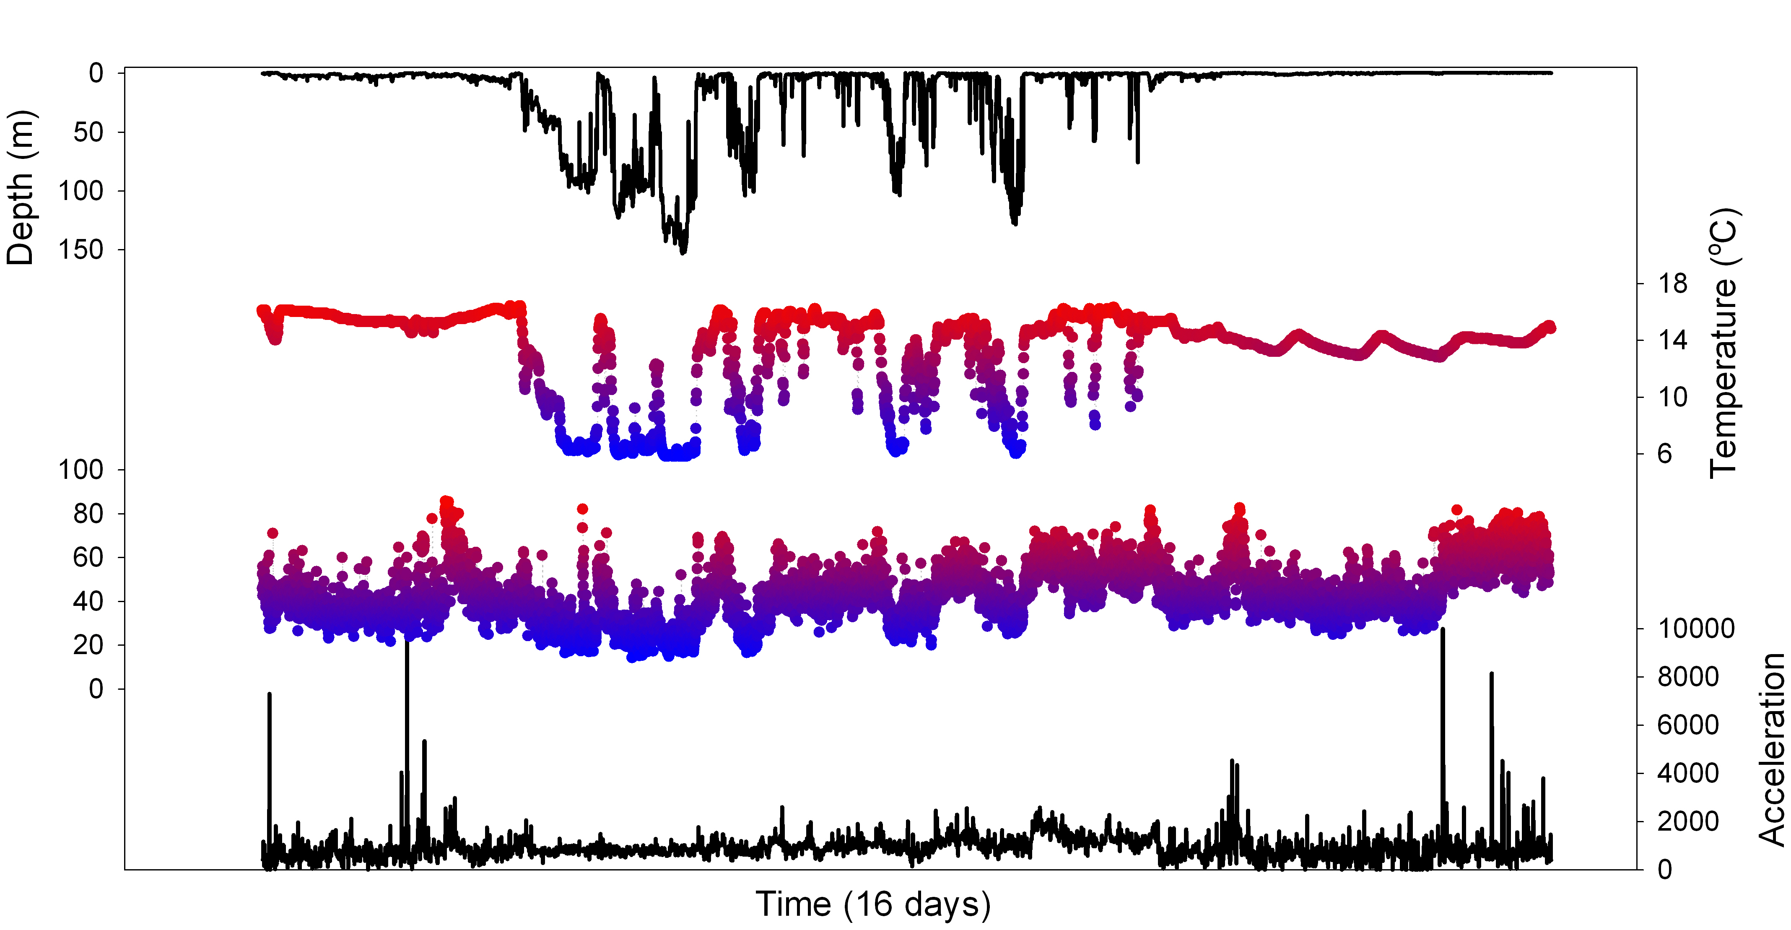
Free-living fish
Allows a ‘fish eye view’ of environmental challenges
Spawning
ground arrival
Depth (m)
River
Lake
River
Metabolism

Slide 12
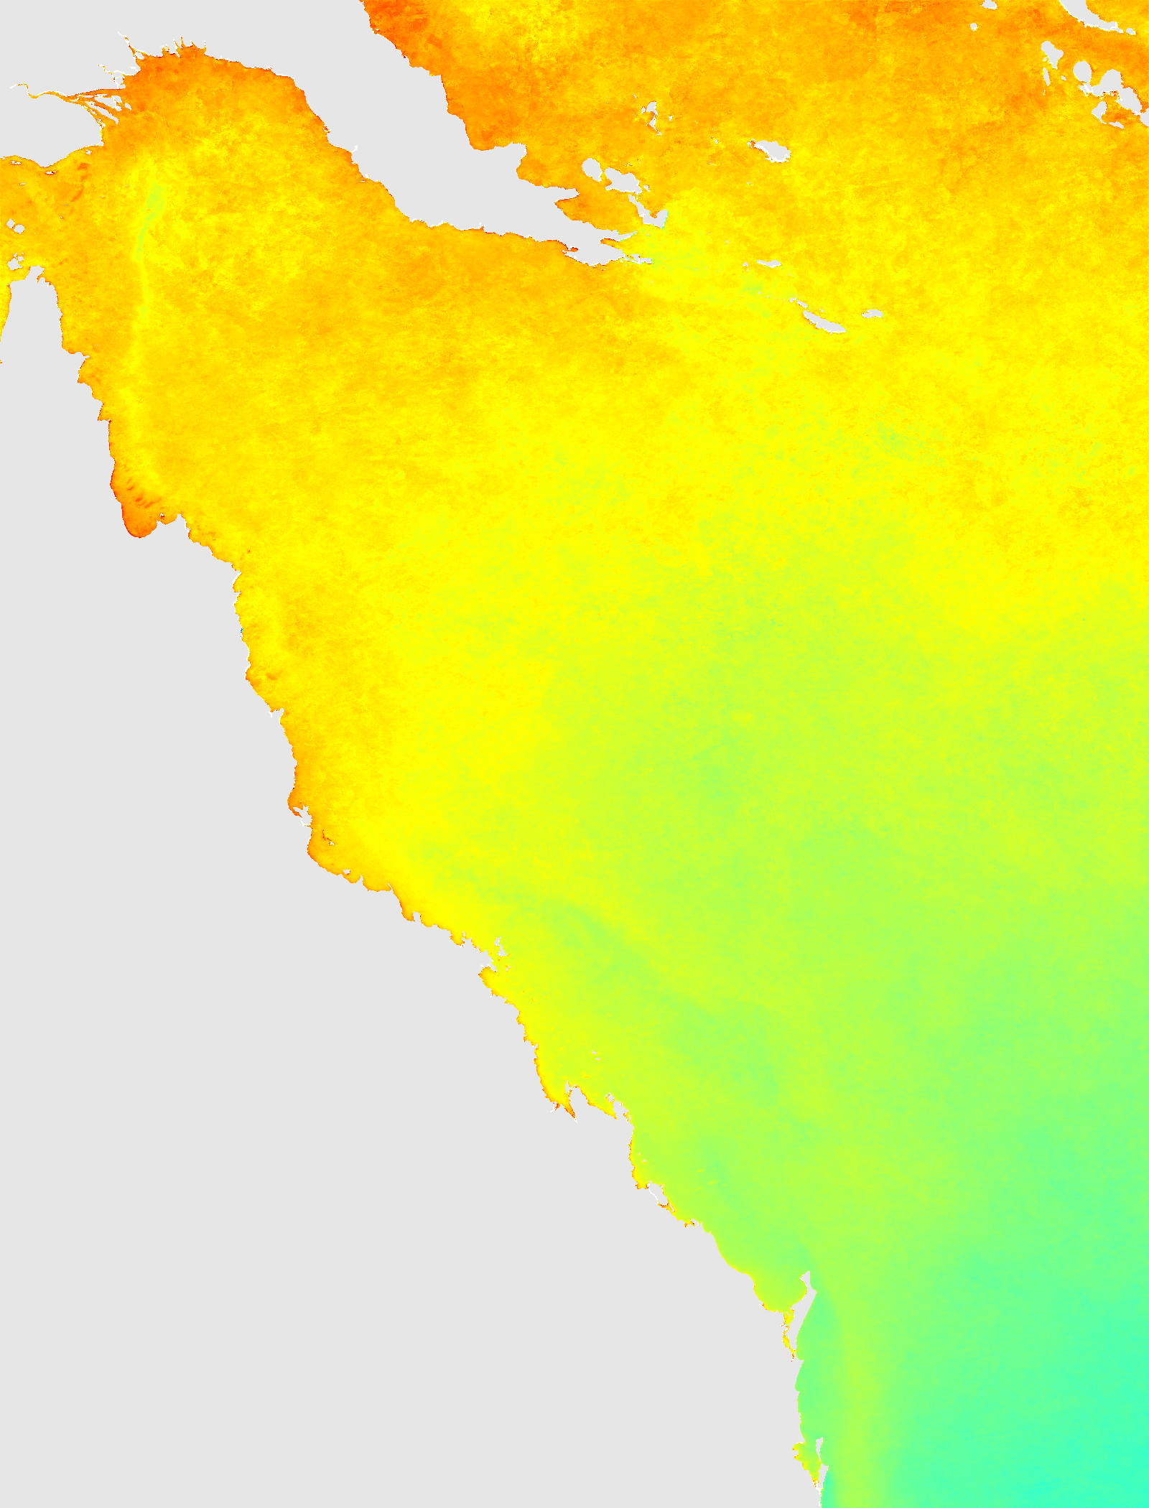
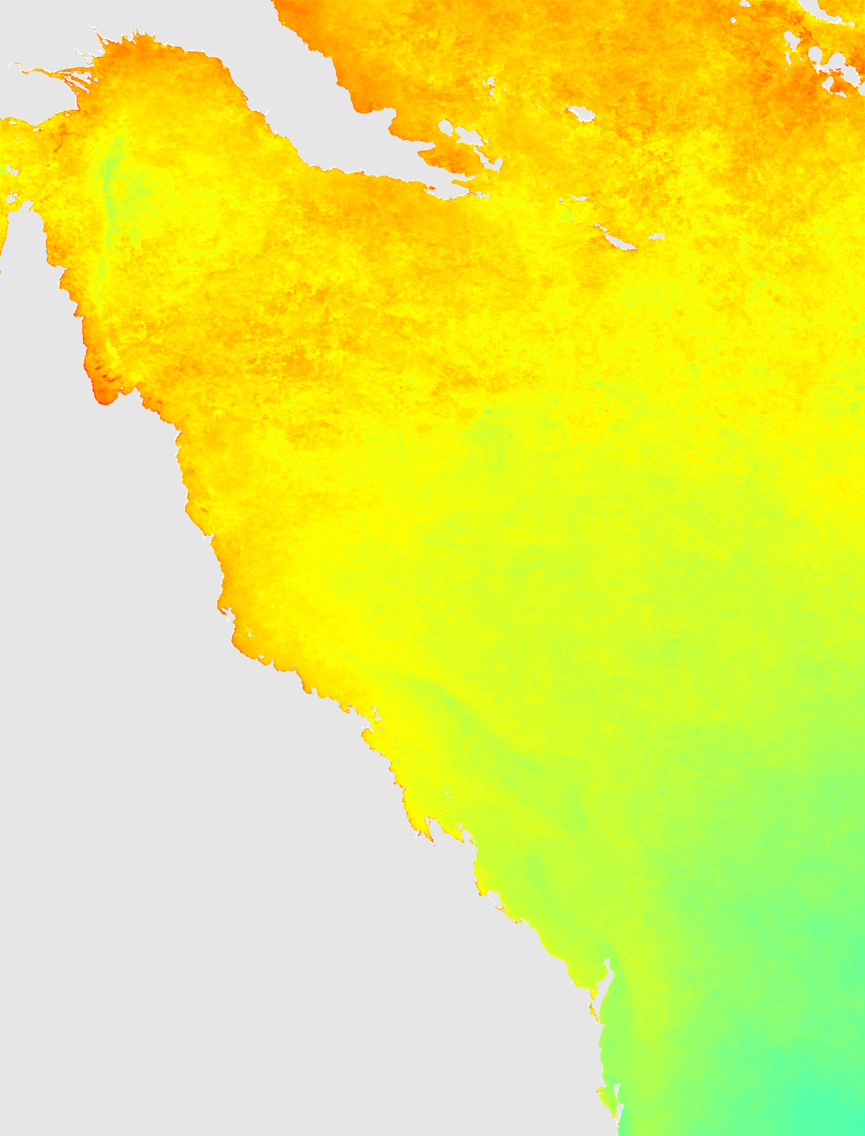
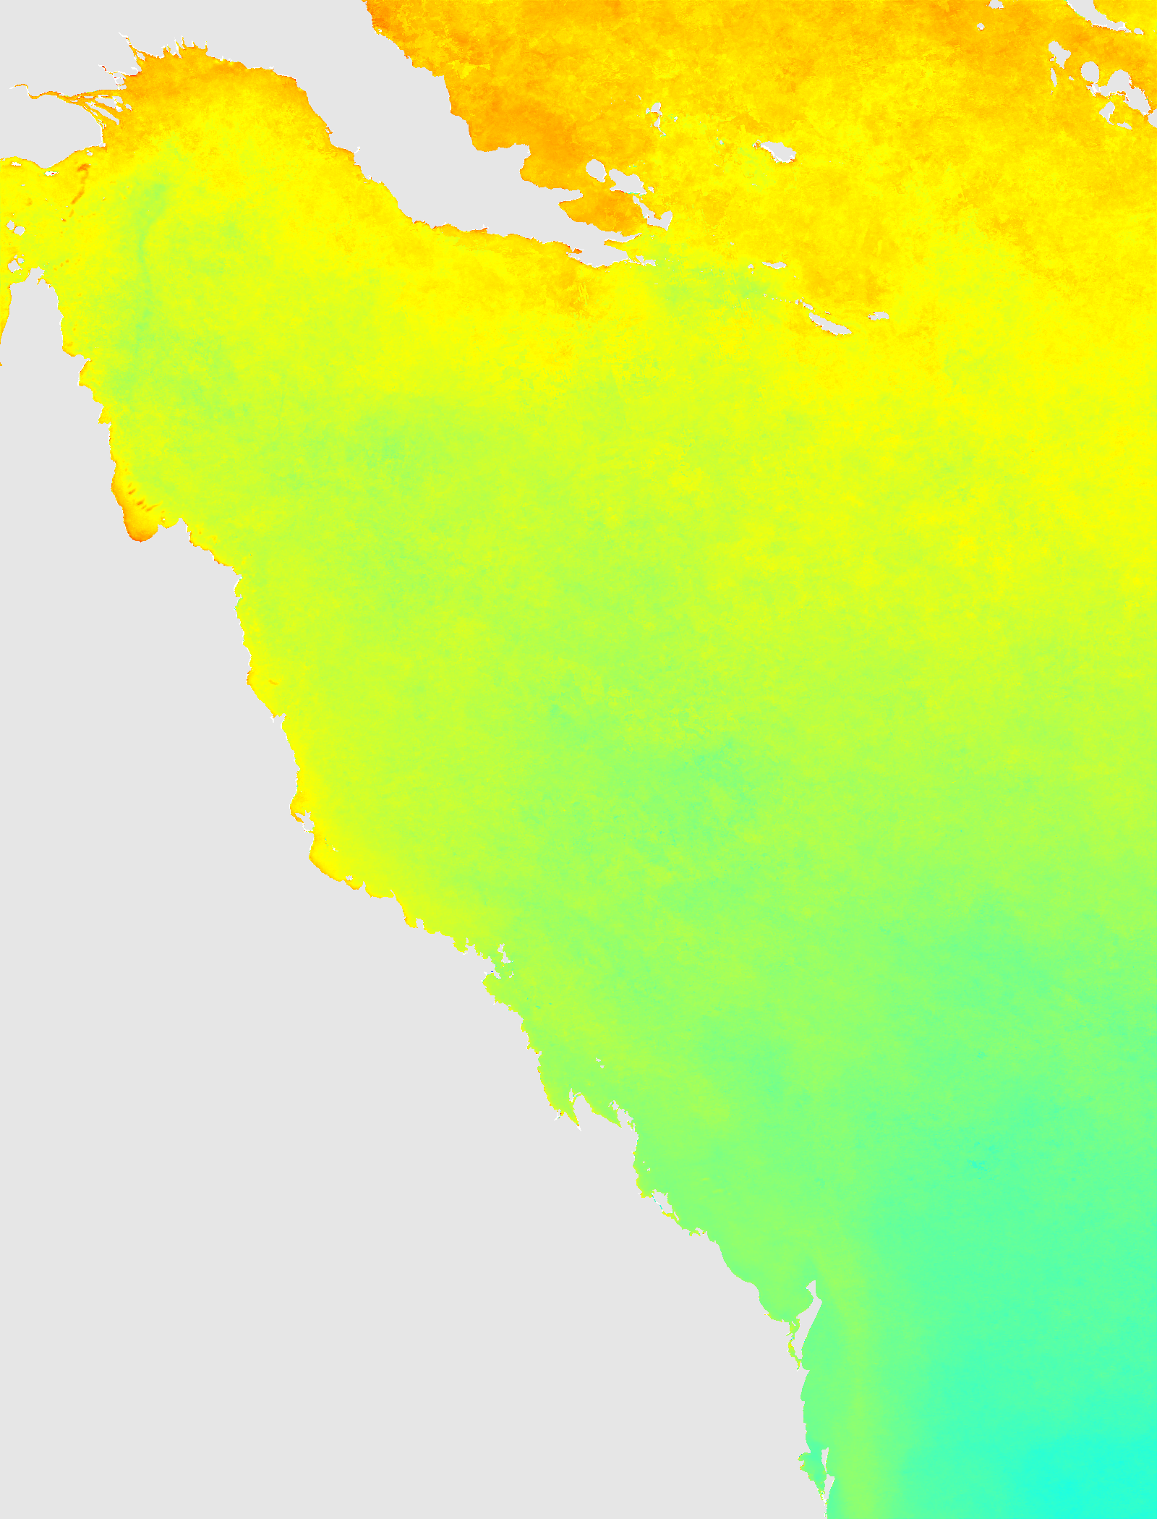
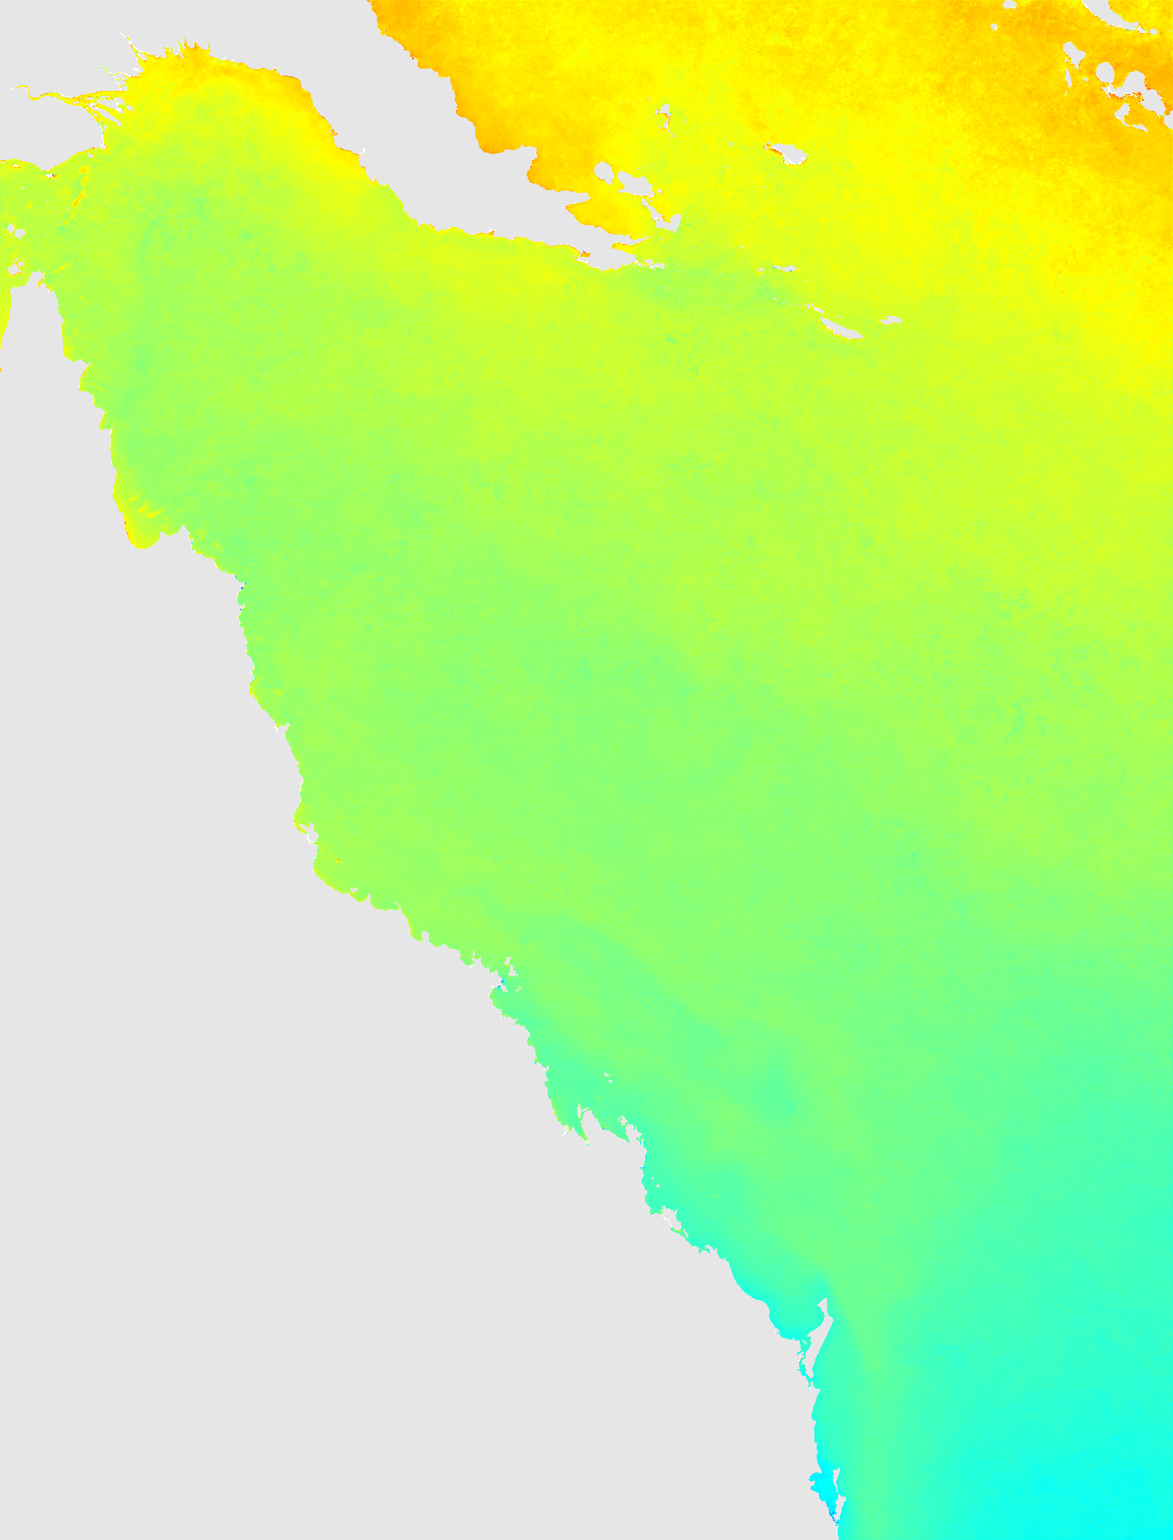
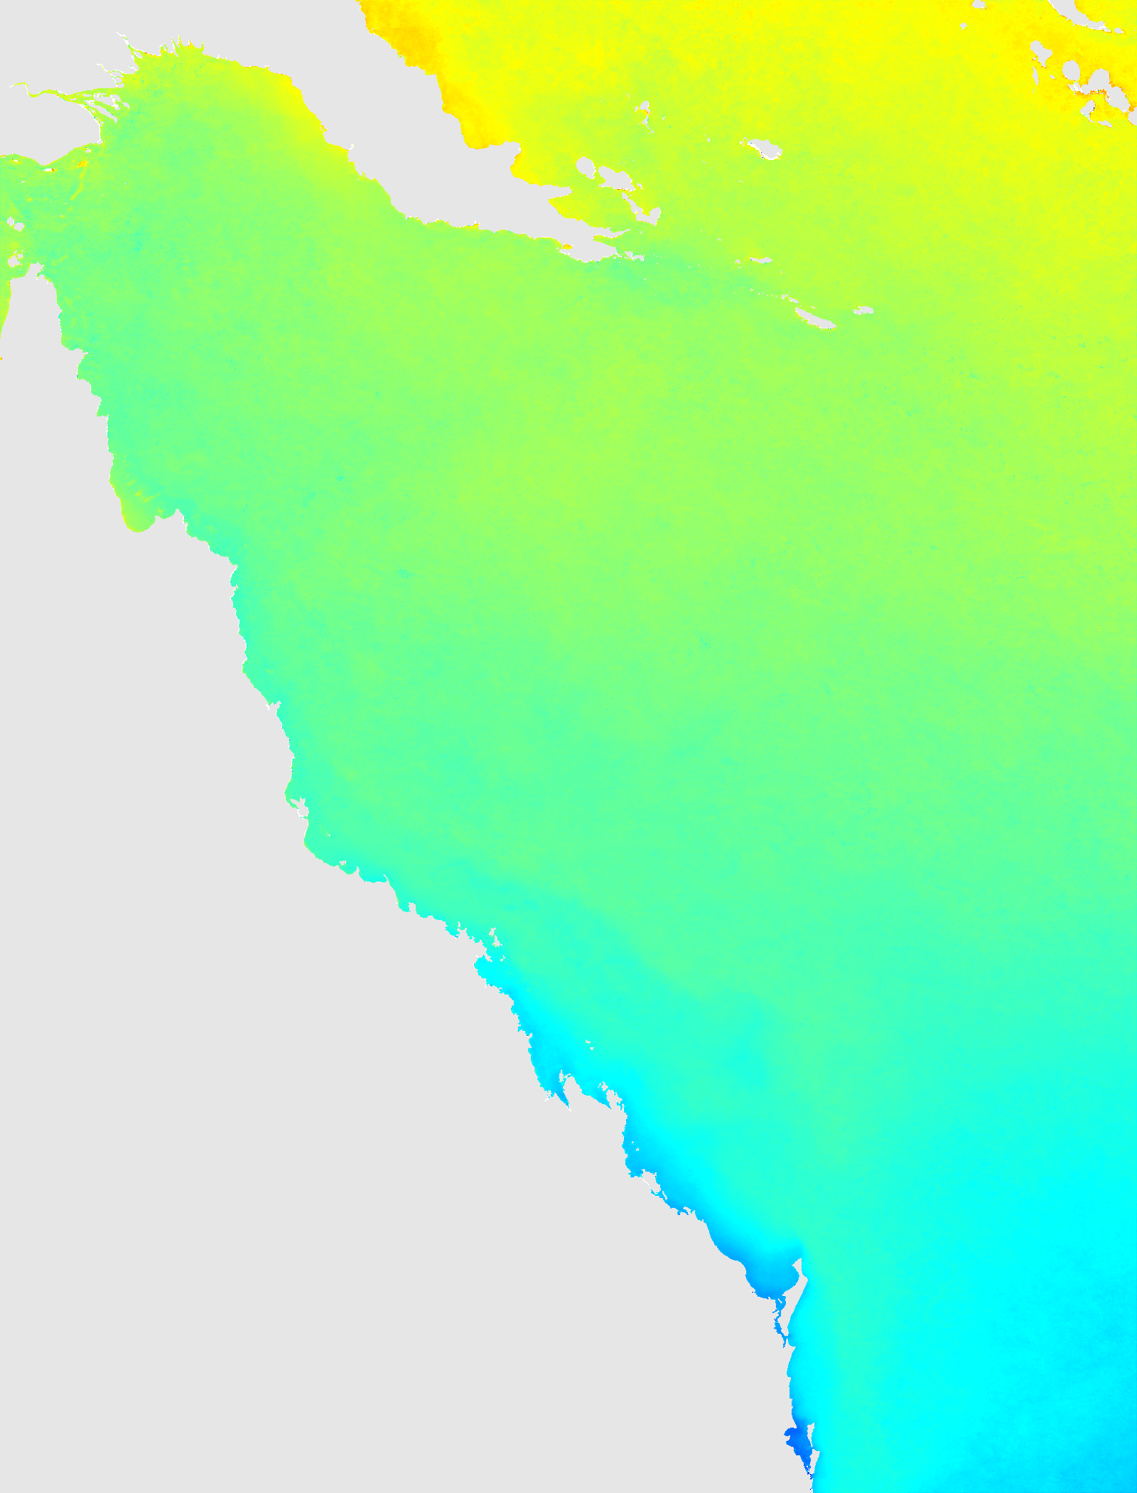
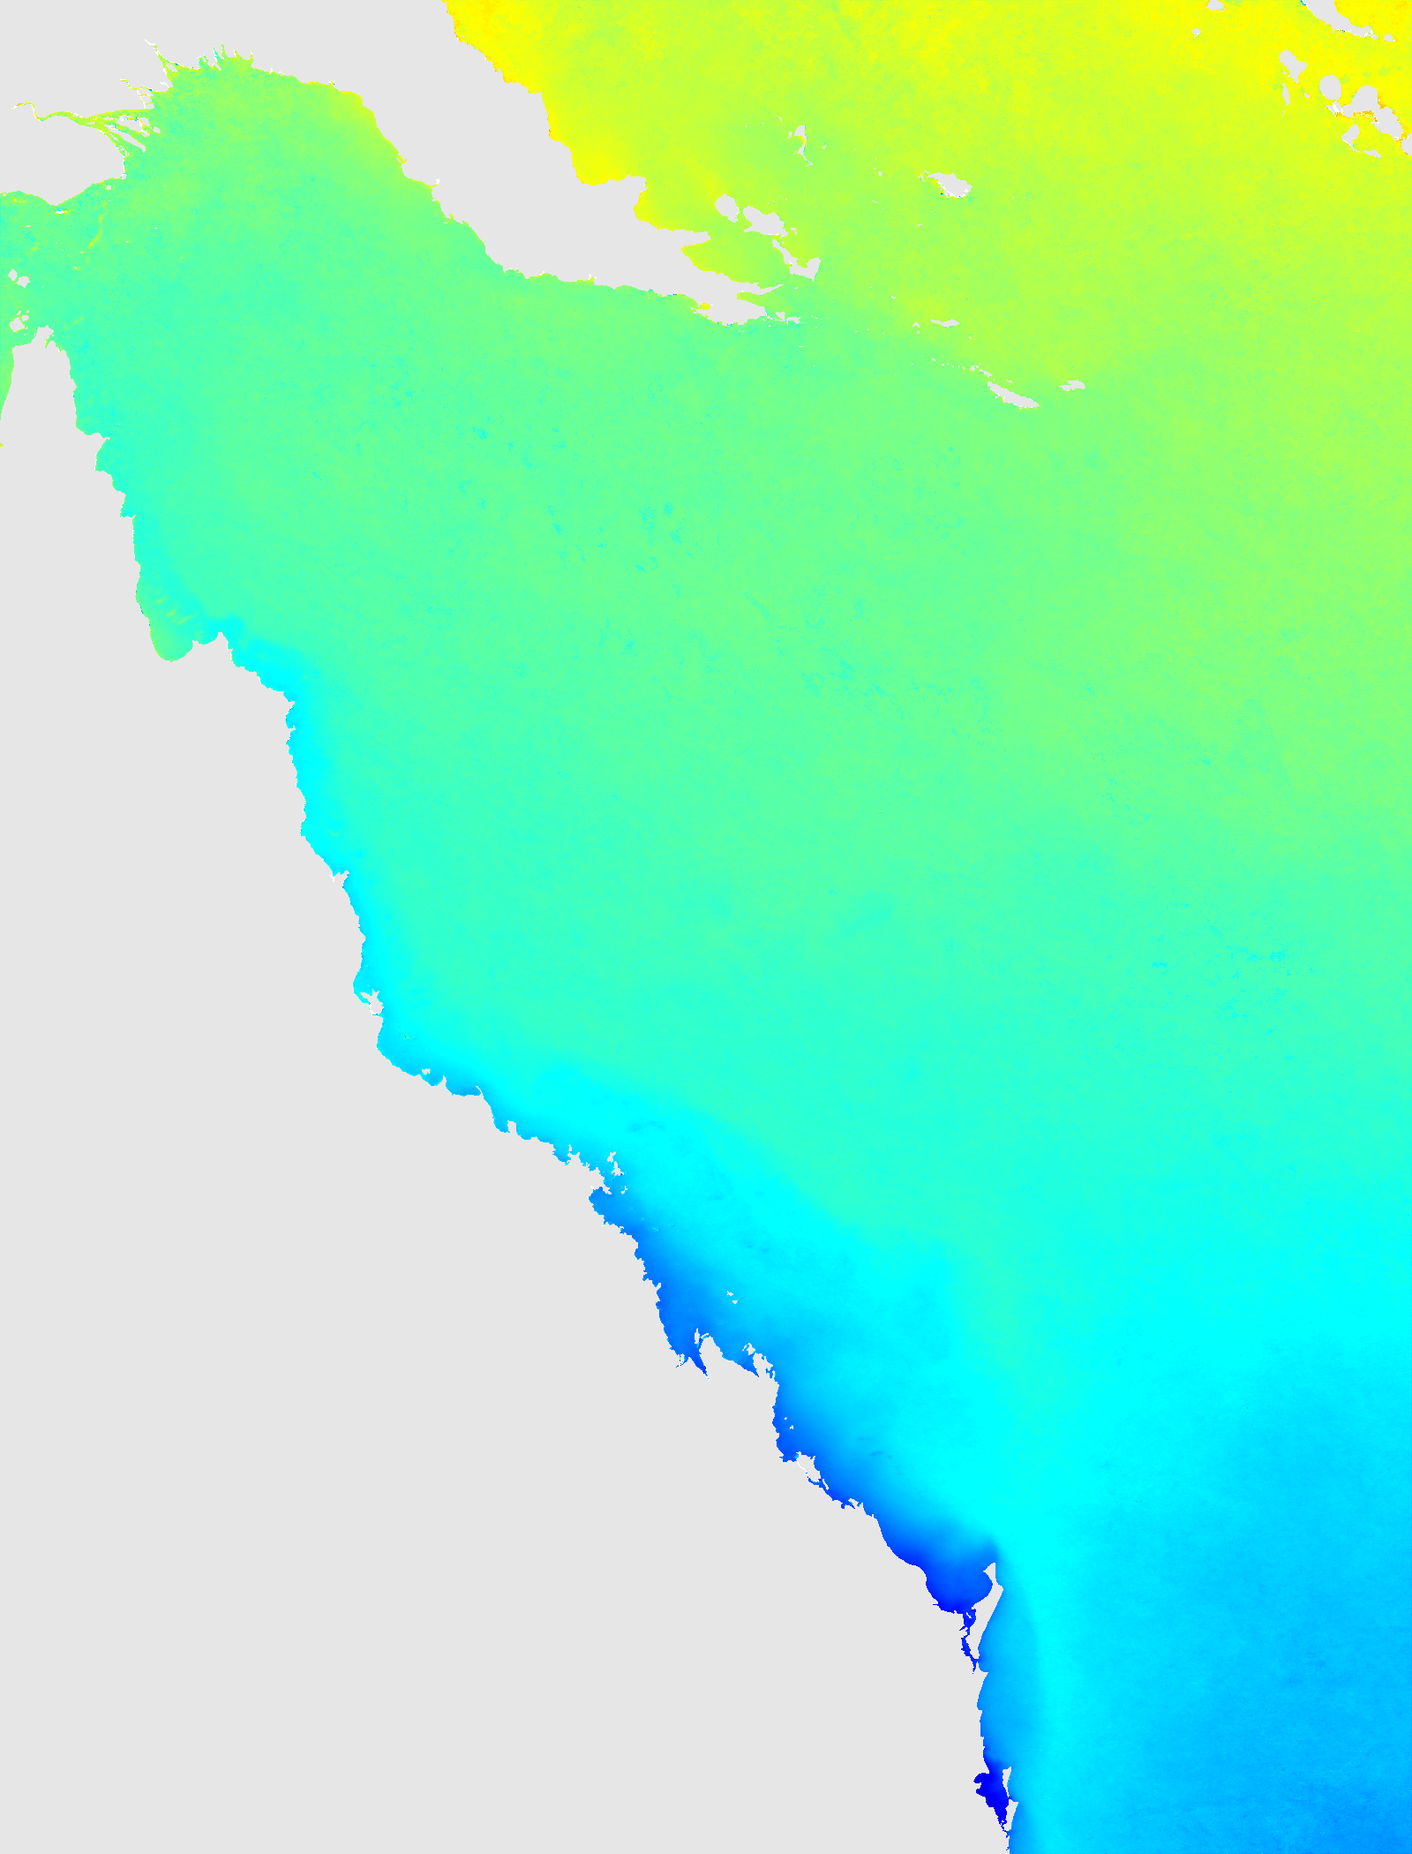
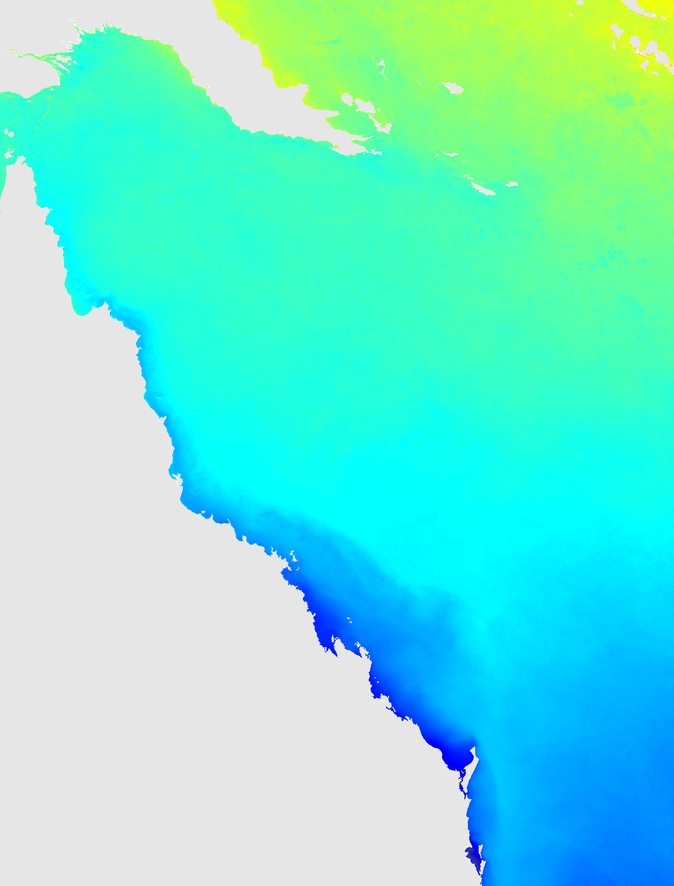
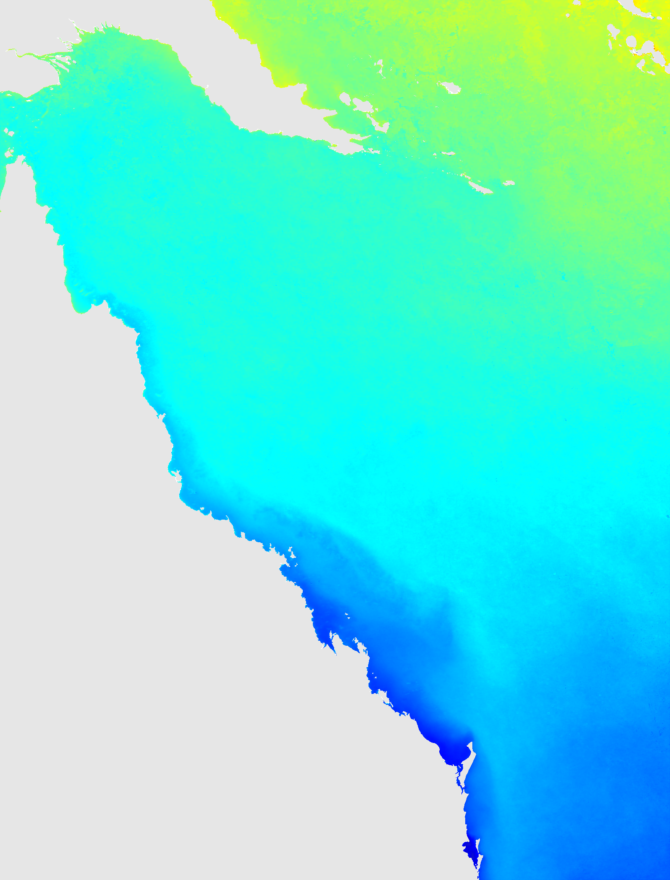
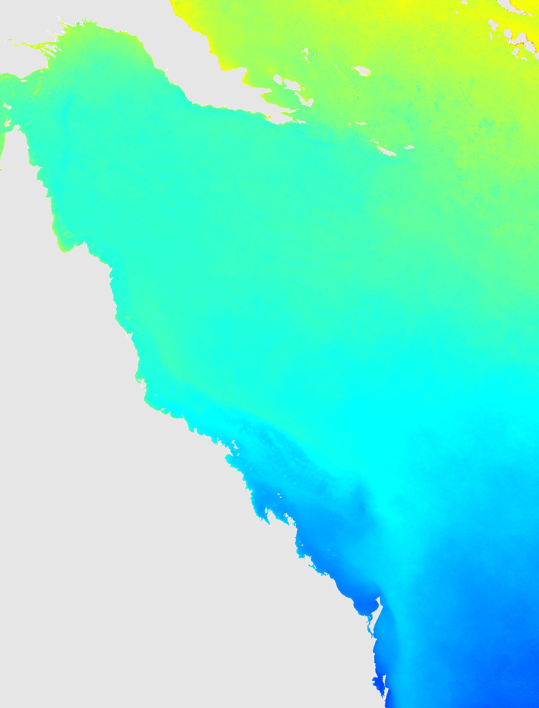
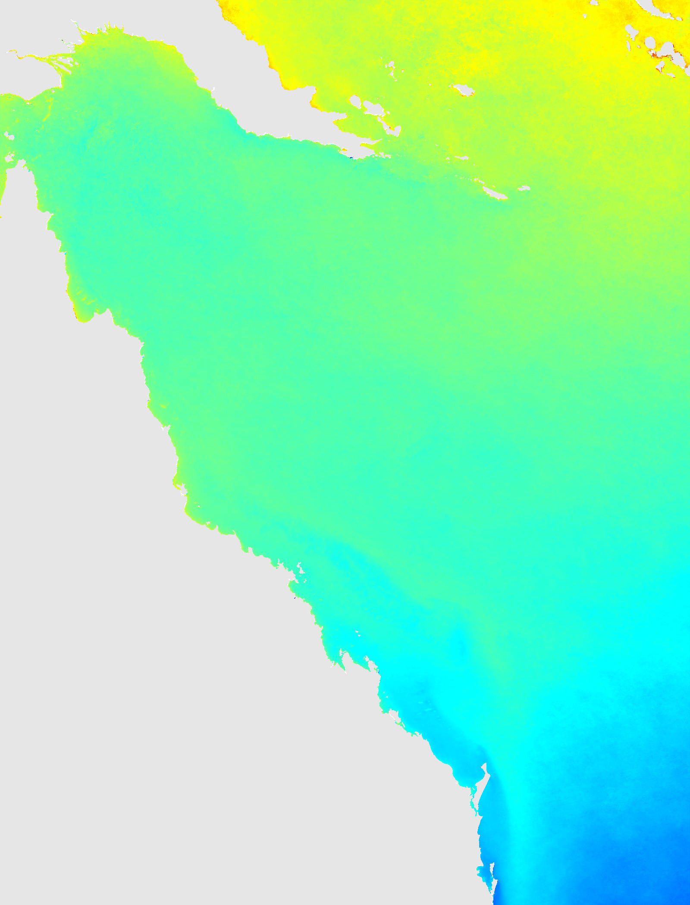
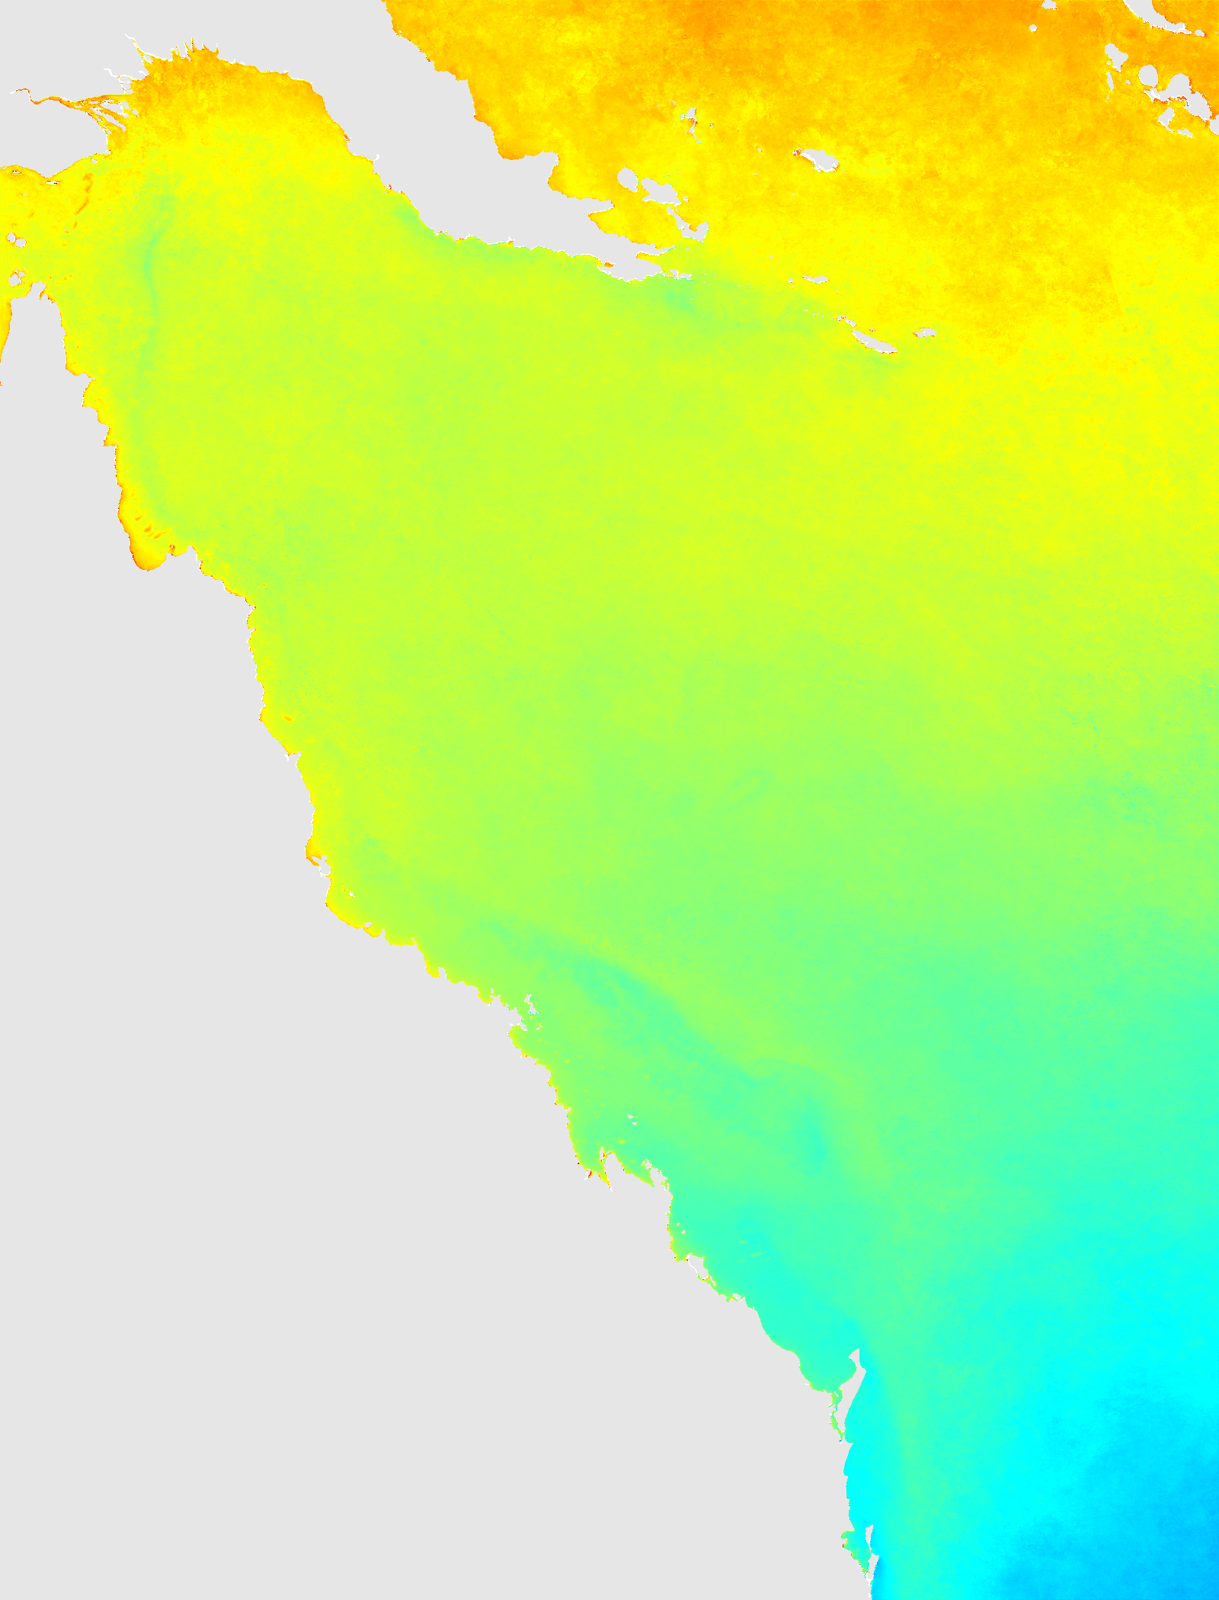
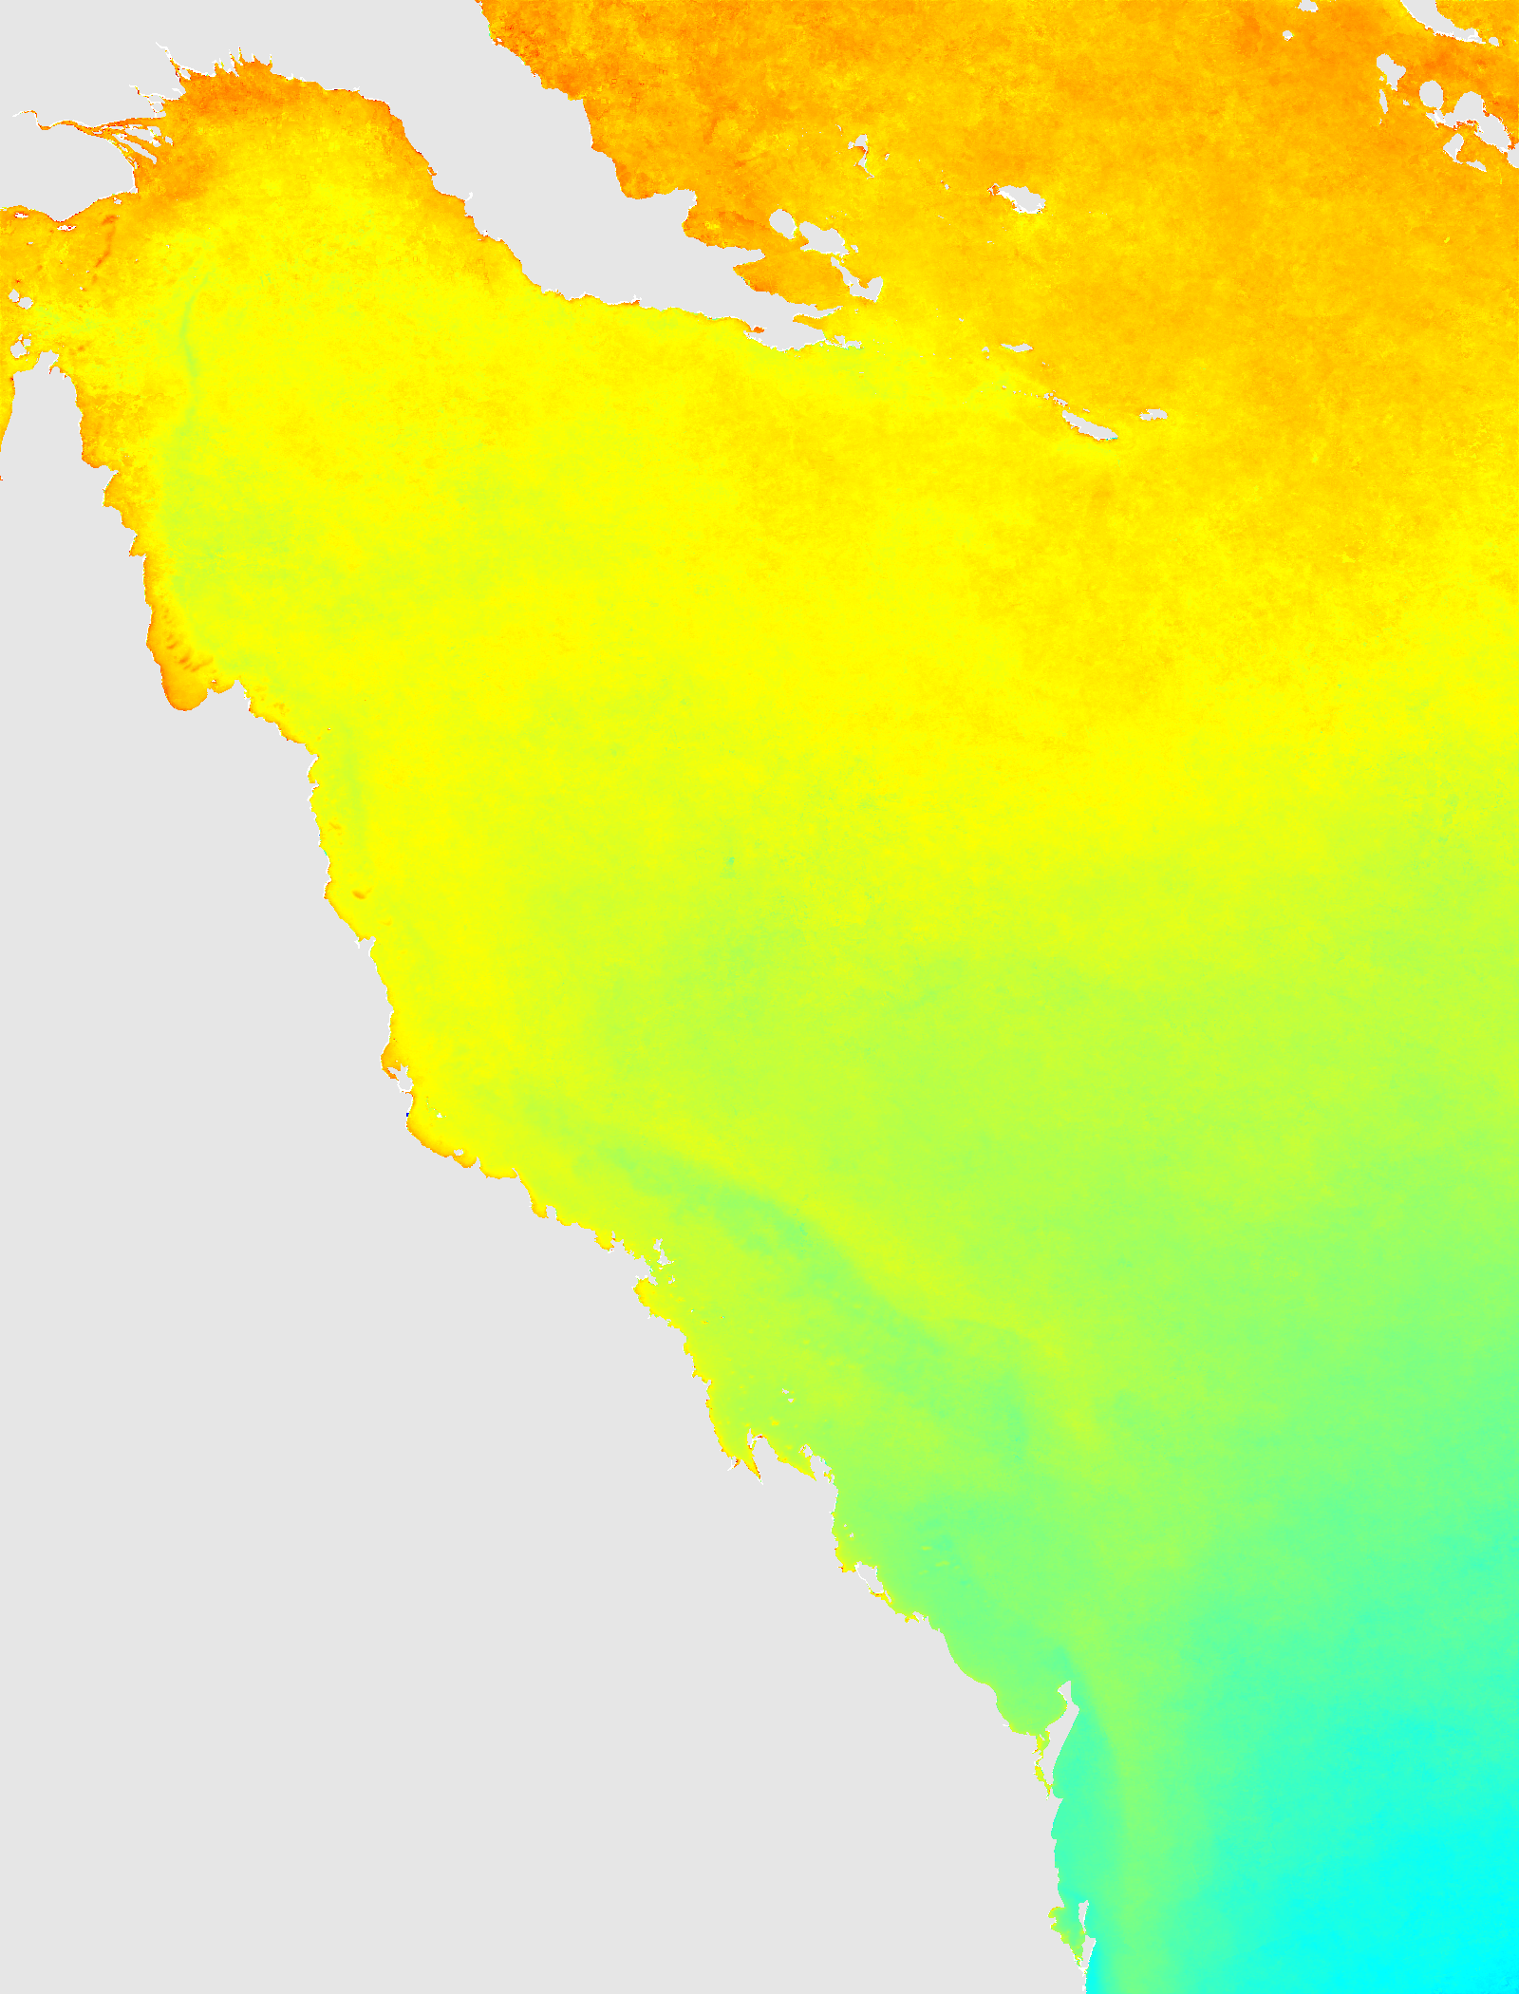
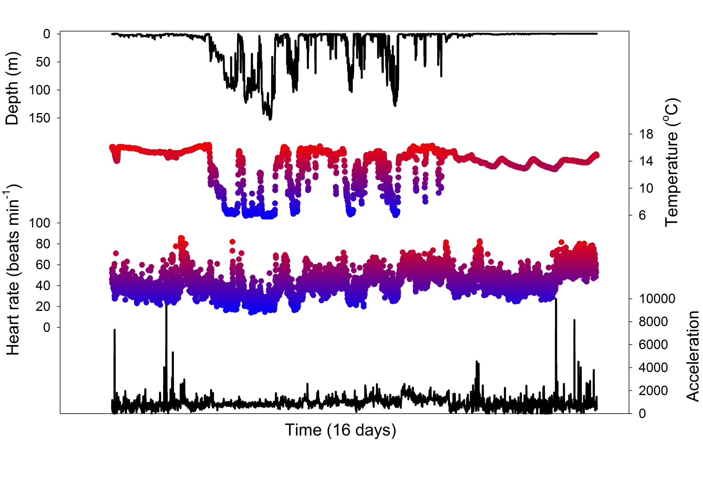

Bio-logging and bio-telemetry
QLD
Movement
Behaviour
Physiology
Preferences
Avoidance
Craig Steinberg

Slide 13
Conclusions
Metabolic capacity provides insight into movement ecology and home ranges of fishes
Metabolic capacity may be influenced by environmental change (e.g., increasing temperature) and differentially with ontogeny → life history consequences
Understanding energy budgets is key → integration of physiology, ecology, electronic engineering and environmental monitoring/modelling

Slide 14

Acknowledgements
Vanessa Messmer (CoE Coral Reef Studies, JCU)
Andrew Tobin (Earth and Env. Sciences, JCU)
Morgan Pratchett (CoE Coral Reef Studies, JCU)
Peter Teakle Sustainable Fishing Research Grant

